Slide 1
River Otter Data Analysis
Cami Hauver – U of U Data Analytics Course 2024

Slide 2
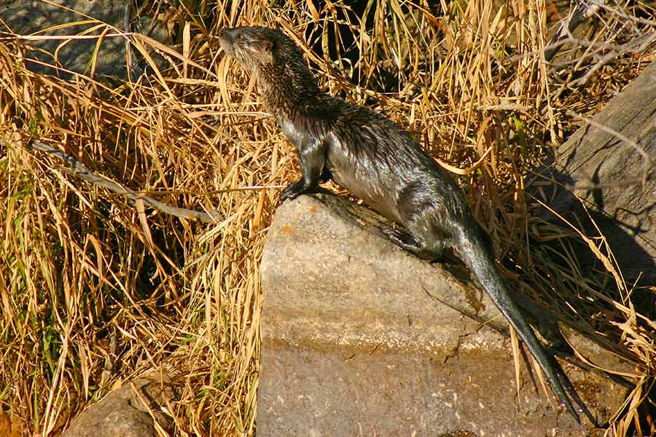
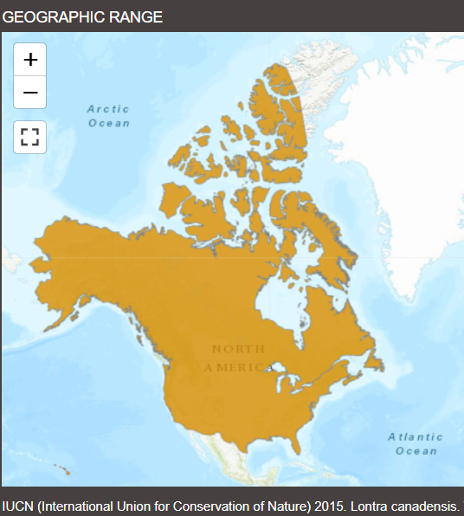
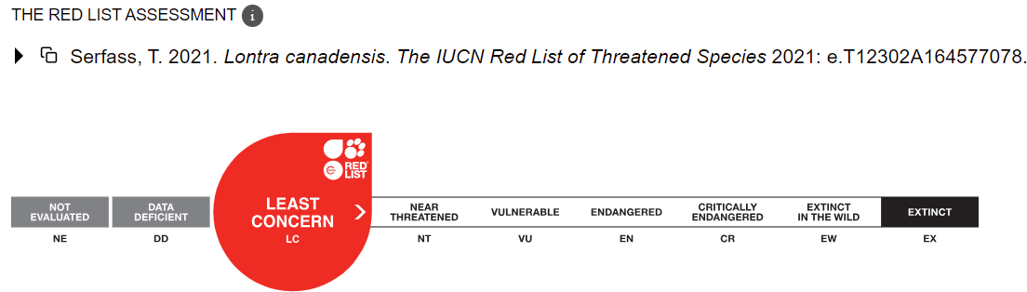
Introduction - Background
Northern river otter (Lontra canadensis)
Native to Utah
Low abundance
Unregulated trapping by early settlers
Habitat loss
Rare Species
No legal harvesting since 1899
67 individuals reintroduced in 1989 and 2000s
Green River
Strawberry
Escalante
Provo River
https://wildlife.utah.gov/news/utah-wildlife-news/1225-dwr-asking-utahns-to-report-otter-sightings.html

Slide 3
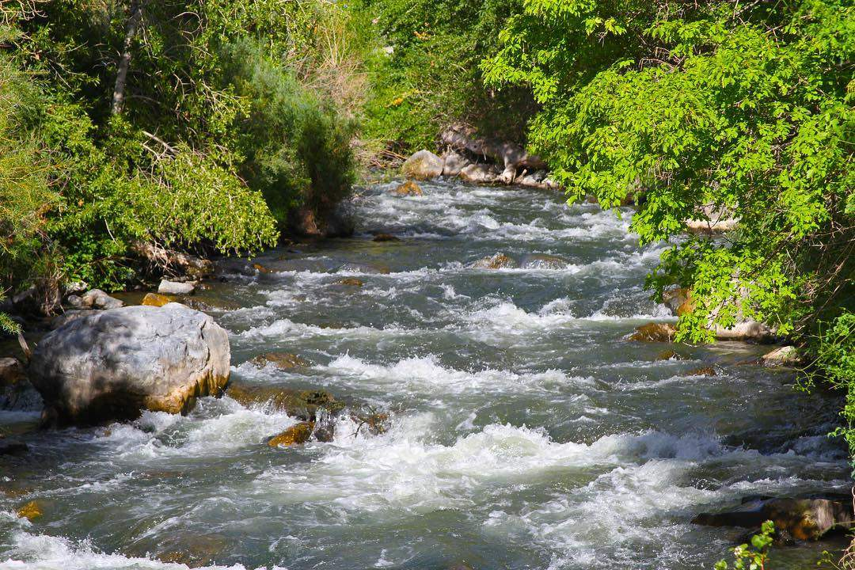
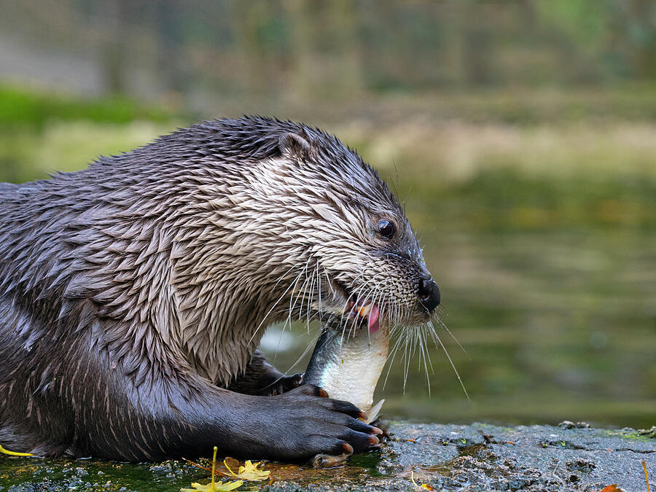
Introduction - Background
Northern river otter (Lontra canadensis)
Difficult to monitor
Secretive
Low densities
No current Utah population estimate
Found in rivers, reservoirs, lakes
Main prey = fish
Important indicator species
Health of aquatic environment
https://wildlife.utah.gov/news/utah-wildlife-news/1225-dwr-asking-utahns-to-report-otter-sightings.html

Slide 4
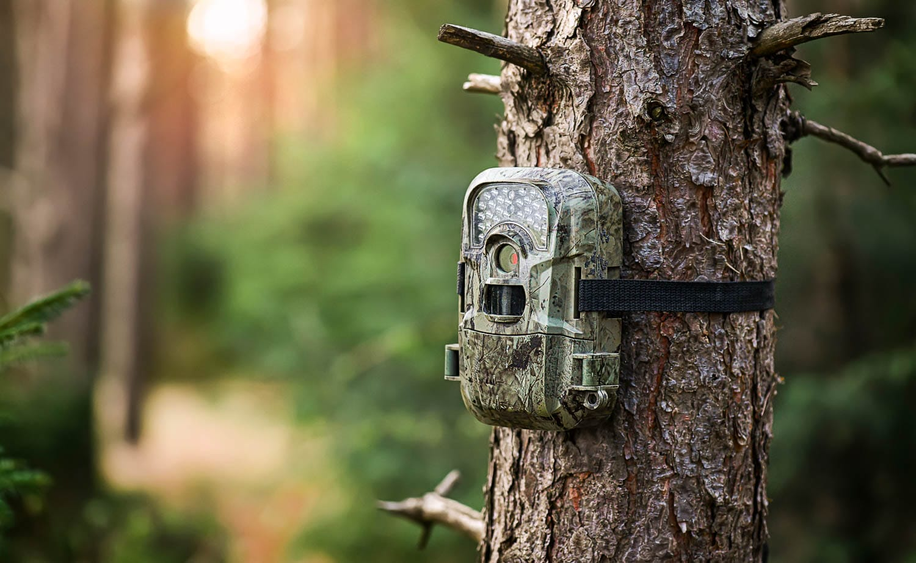
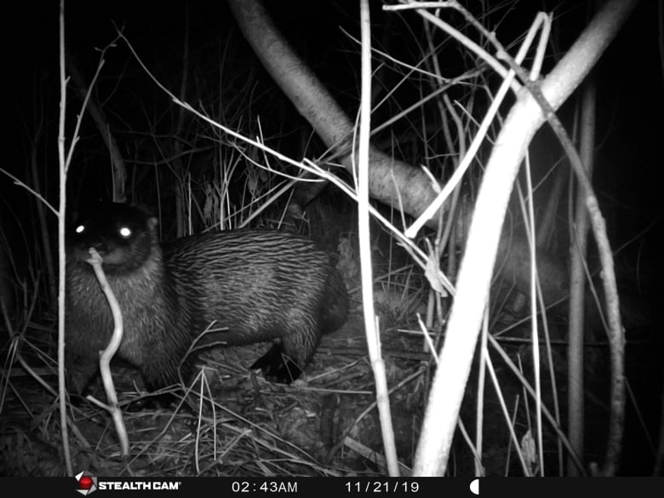
Introduction - Data
Anonymous data contributor
Conservation research project
Volunteer surveyors
Data entry from trail cam footage
Lower Provo River
Middle Provo River
Strawberry River
Weber River
Researcher is primarily interested in presence/absence of river otters and other species overlap
https://www.cbc.ca/news/canada/prince-edward-island/pei-river-otter-trail-cam-more-sightings-1.7158491

Slide 5
Objectives
Reformat/clean data
Perform exploratory analysis:
How do animal sightings differ between survey locations?
Which individual surveys within each location had the most/least animal sightings?
Where were river otters sighted, and how often were they sighted compared to other animals?
Compare probabilities of other animal sightings to river otter sightings. Are there any possible patterns?

Slide 6
Methods
Original Data (protected)
Inconsistent entry
Manually re-entered/compiled into a single excel spreadsheet w/ 6 columns:
Location, Survey #, Camera #, SD Card, Animal Sighted, Animal Count
310 rows
Altered Data:
Modified animals sighted (find/replace, manually altered some)
Exported as CSV
Imported into Jupyter Notebook
Pandas
Matplotlib
Scipy.stats

Slide 7
Methods
Further Cleaning:
Replace misspelled or close-duplicate Animals Sighted
Did not use
“Camera #”, “SD Card”, “Animal Count”
Able to analyze animal presence/absence with “Animals Sighted” only
Compiled various pandas dataframes and matplotlib plots
Calculated Animal Sighting Probabilities at Otter Sites and compared to Non-Otter Sites
Heatmap w/ Seaborn for plotting probabilities and searching for patterns

Slide 8
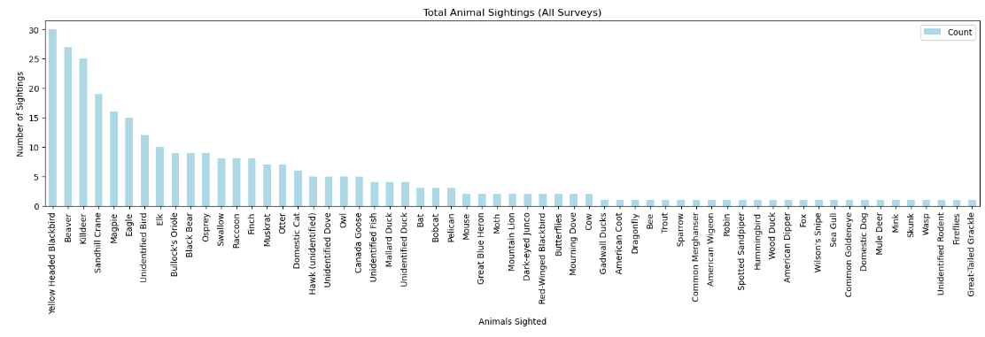
Results
309 animal sightings total
61 different species

Slide 9
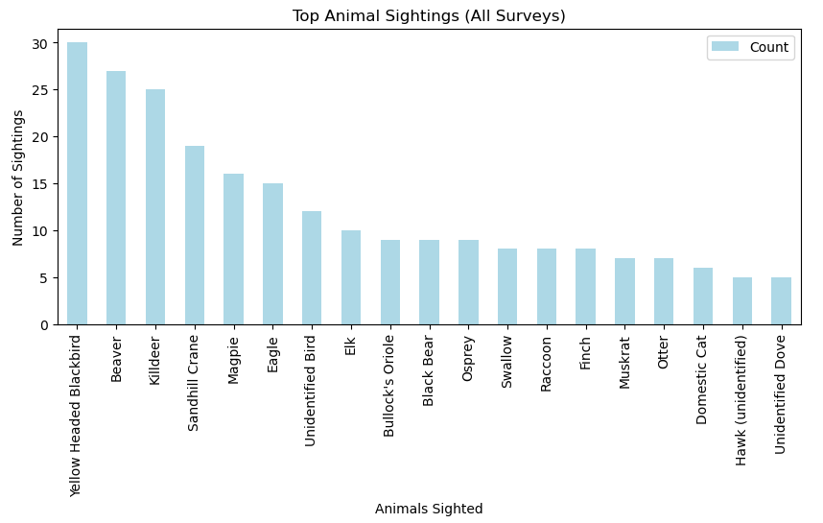
Results

Slide 10
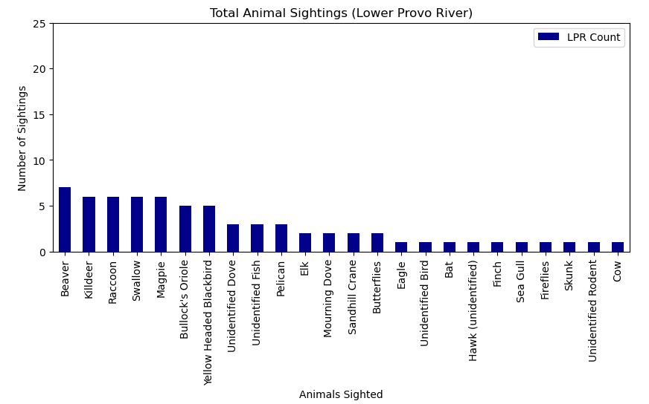
Results
Lower Provo River
Top Animals Sighted
Beaver
Killdeer
Raccoon
Swallow
Magpie

Slide 11
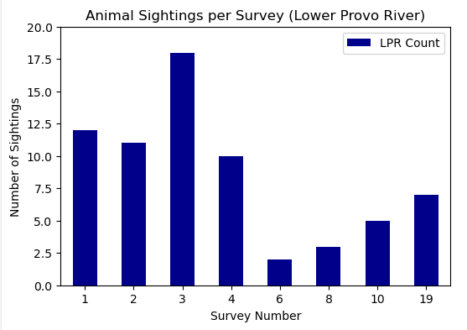
Results
Lower Provo River
Survey # stats:
Mean = 8.5
Max = 18
(#3)
Min = 2
(#6)

Slide 12
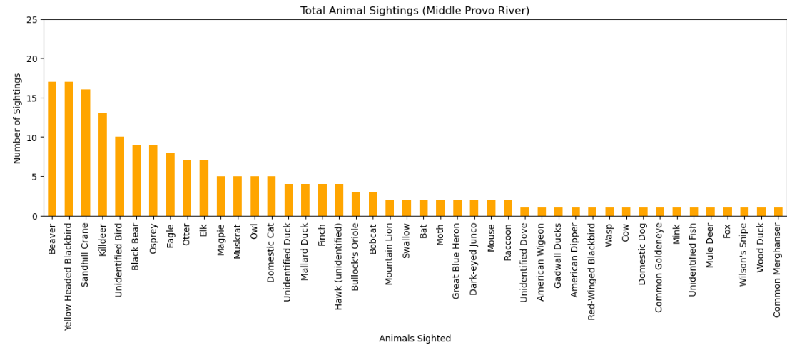
Results
Middle Provo River Top Animals Sighted = Beaver, Yellow-Headed Blackbird, Sandhill Crane, Killdeer, Unidentified Bird

Slide 13
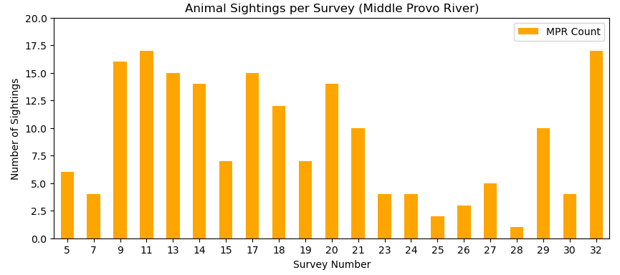
Results
Middle Provo River
Survey # stats:
Mean = 8.9
Min = 1
(#28)
Max = 17
(#11, #32)

Slide 14
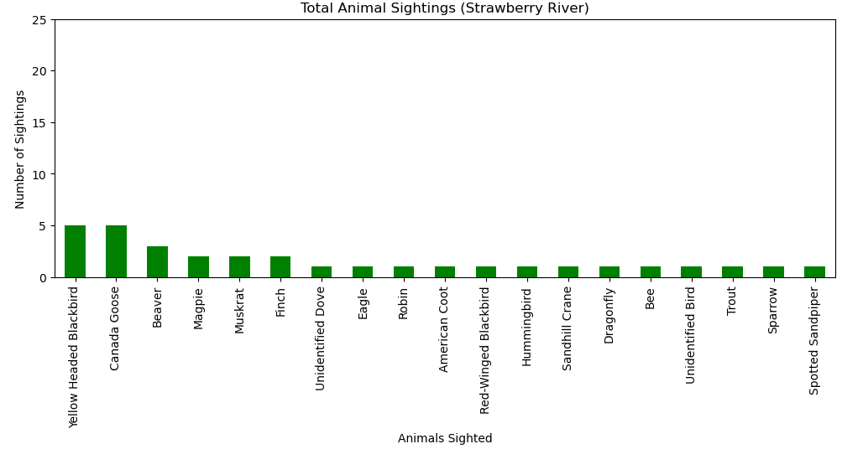
Results
Strawberry River
Top Animals Sighted
Yellow Headed Blackbird
Canada Goose
Beaver
Magpie
Muskrat

Slide 15
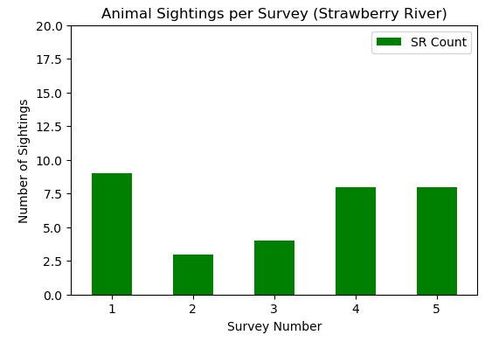
Results
Strawberry River
Survey # stats:
Mean = 6.4
Max = 9
(#1)
Min = 3
(#2)

Slide 16
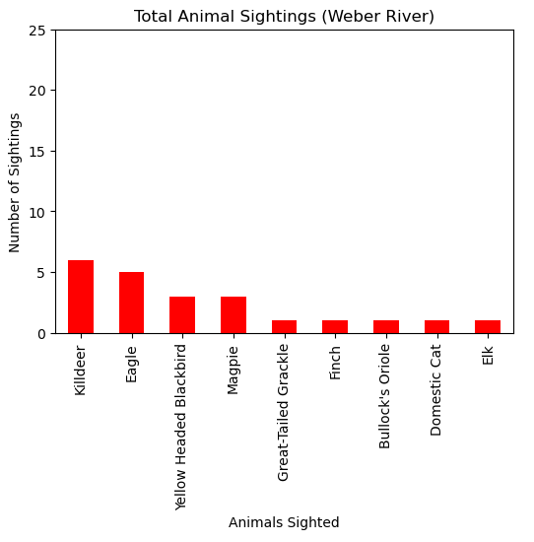
Results
Weber River
Top Animals Sighted
Killdeer
Eagle
Yellow Headed Blackbird
Magpie

Slide 17
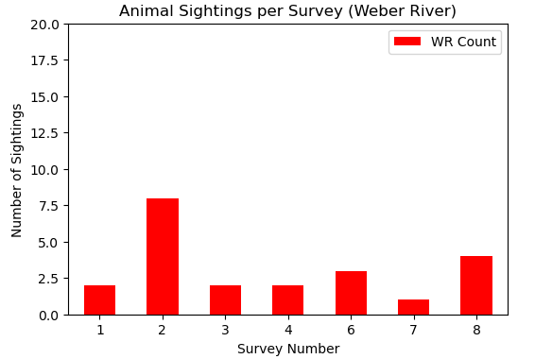
Results
Weber River
Survey # stats:
Mean = 3.1
Max = 8
(#2)
Min = 1
(#7)

Slide 18
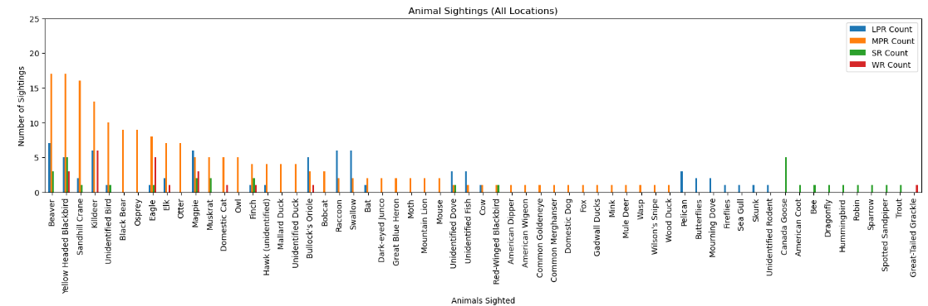
Results

Slide 19
Results
Otter Sites:
7 sightings total
Middle Provo River only
Survey #s
#5
#13
#15
#17
#18
#32

Slide 20
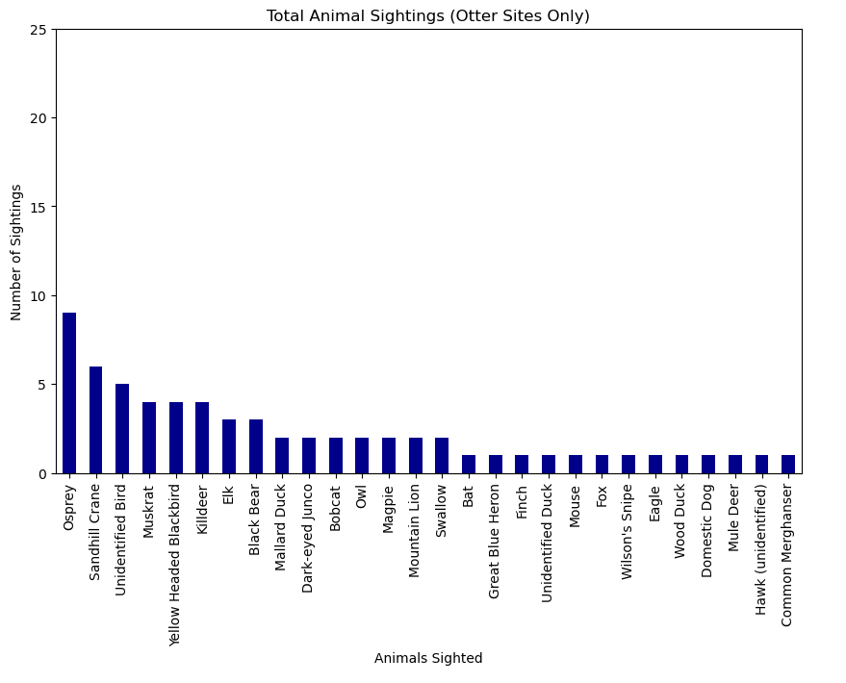
Analysis
Top Animals Sighted at Otter Sites:
Osprey
Sandhill Crane
Unidentified Bird

Slide 21
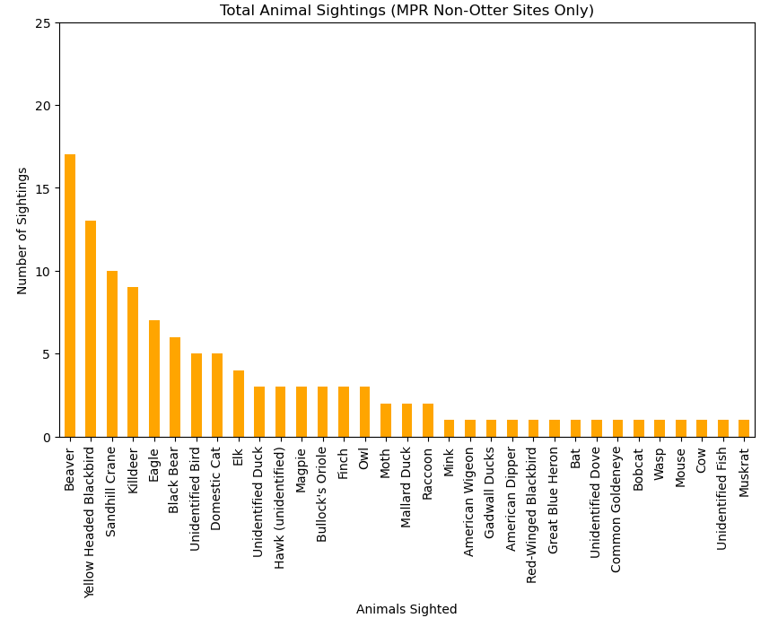
Analysis
Top Animals Sighted at Non-Otter Sites:
Beaver
Yellow Headed Blackbird
Sandhill crane

Slide 22
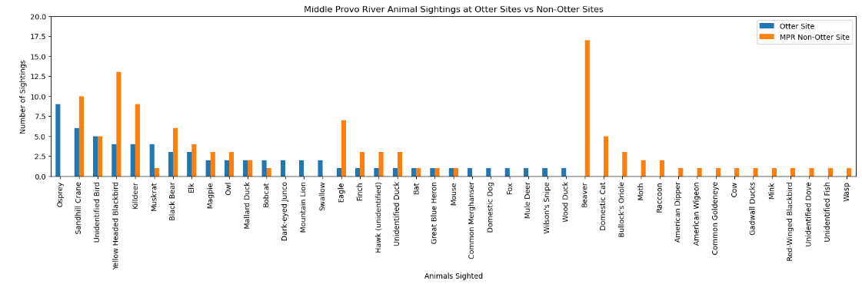
Analysis

Slide 23
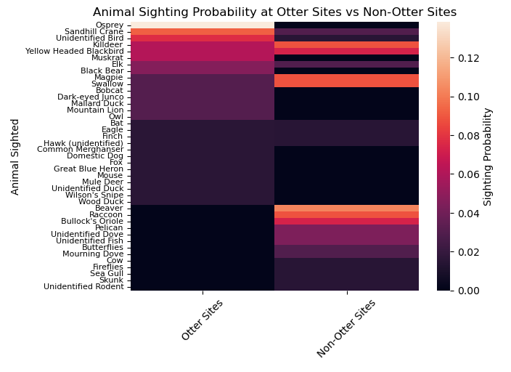
Analysis
Otter Sites:
Much higher probability of sighting an Osprey
Sandhill crane
Non-Otter Sites:
Much higher probability of sighting a
Beaver
Racoon

Slide 24
Conclusion
How do animal sightings differ between survey locations?
Lower Provo River
68 animal sightings
24 different species
8 surveys performed
Middle Provo River
Most animal sightings
187
Most diversity
44 different species
Most number of surveys performed
21 surveys
Strawberry River
32 animal sightings
19 different species
Least number of surveys performed
5 surveys performed
Weber River
Least animal sightings
22 animal sightings
Least diversity
9 different species
7 surveys performed

Slide 25
Conclusion
2. Which individual surveys within each location had the most/least animal sightings?
Lower Provo River
Most animal sightings
Survey #3 (18)
Least animal sightings
Survey #6 (2)
Middle Provo River
Most animal sightings
Survey #11 and #32 (17)
Least animal sightings
Survey #28 (1)
Strawberry River
Most animal sightings
Survey #1 (9)
Least animal sightings
Survey #2 (3)
Weber River
Most animal sightings
Survey #2 (8)
Least animal sightings
Survey #7 (1)

Slide 26
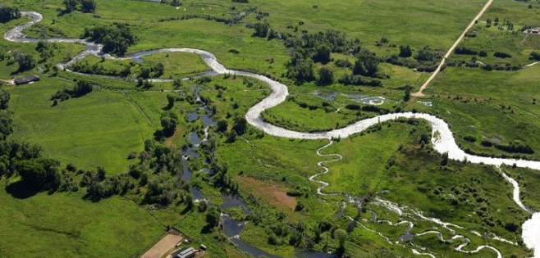
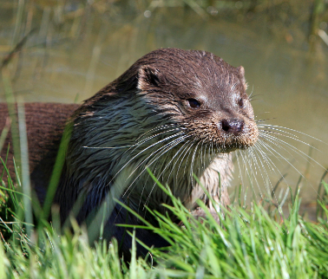
Conclusion
3. Where were river otters sighted, and how often were they sighted compared to other animals?
7 sightings out of 187 total = 0.0374 sighting probability on MPR
9th most sighted animal on MPR out of 44 different species
Middle Provo River only
Survey #s
#5
#13
#15
#17
#18
#32

Slide 27
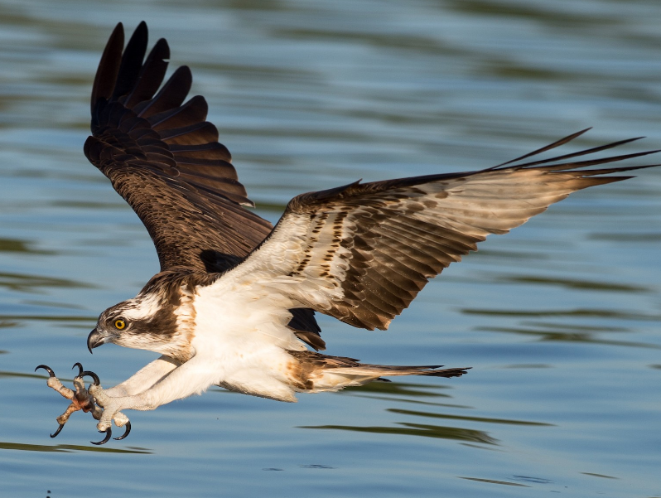
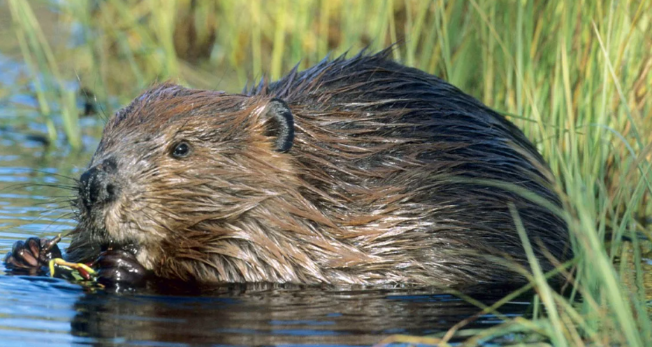
Conclusion
Compare probabilities of other animal sightings to river otter sightings. Are there any possible patterns?
Otter Sites:
Much higher probability of sighting an Osprey
Sandhill crane
Non-Otter Sites:
Much higher probability of sighting a
Beaver
Racoon

Slide 28
Conclusion
4. Compare probabilities of other animal sightings to river otter sightings. Are there any possible patterns?
Possible explanation:
Habitat overlap between otters and osprey
Shared prey items
Habitat separation between otters and beavers
Negative interactions
Different environment preferences

Slide 29
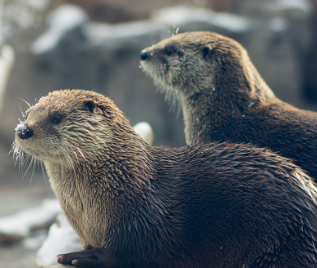
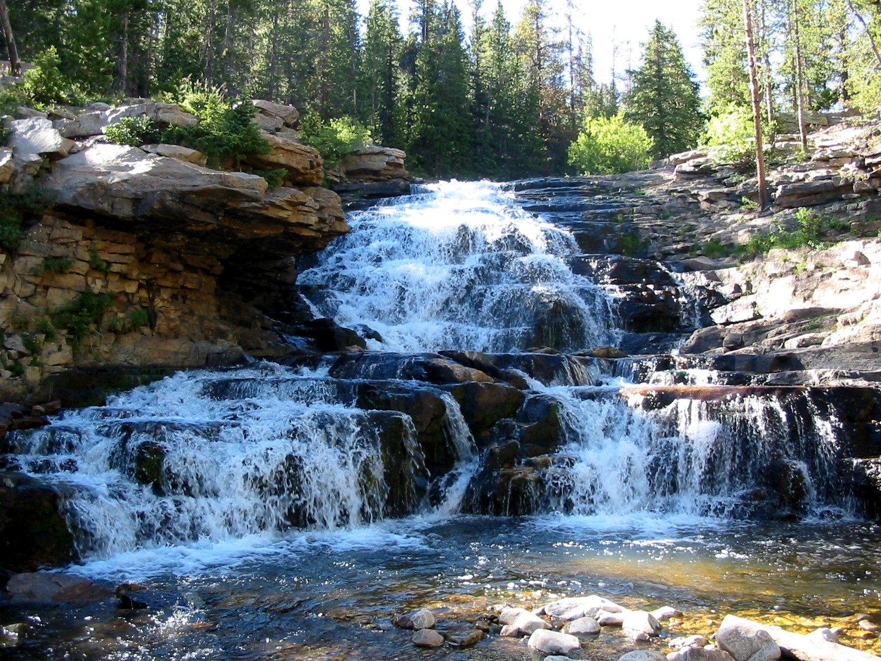
Suggestions for Next Steps
Run statistical tests on how animal sighting probabilities at otter sites compare to non-otter sites
Contingency table
Chi-squared to test for goodness of fit or independence
Collect data on other environmental factors to identify habitat preferences
Vegetation
River characteristics (flow, depth)

Slide 30
Questions?

Slide 31
Resources
https://wildlife.utah.gov/news/utah-wildlife-news/1225-dwr-asking-utahns-to-report-otter-sightings.html
https://www.iucnredlist.org/fr/species/12302/164577078#geographic-range

